Slide 1
Daily Study
2017/01/02
김서진

Slide 2
읽은 논문 리스트
Server Trace Analysis for an Optimal Design of Solid State Drives[IJAER’16] (17/12/05)
Write-off loading: Practical power Management for Enterprise Storage [FAST’08] (17/12/06~)
Don’t Let RAID Raid the Lifetime of your SSD Array [Hotstorage’13] (17/12/11~)
Addressing the Dark Side of Vision Research: Storage [Hotstorage’17] (17/12/21~)

Slide 3
Addressing the Dark Side of Vision Research: Storage [Hotstorage’17]
Goal
Improve visual processing run-times
Motivation
The storage research can strongly influence visual processing run-times:
efficient metadata storage and new storage formats for visual data.
Solution
Propose a storage architecture designed for efficient visual data access that exploits next generation hardware

Slide 4
Today 공부한 내용
Common approach
Run the neural network again, an approach which is not scalable.
Exploit rich metadata
Way to speed up access to desired data: Analysis friendly formats
Trade off between performance and data loss

Slide 5
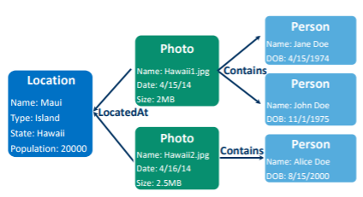
Today 공부한 내용
Visual Metadata as a Graph
Property graph
Nodes connected with Edges ex. Location, Person
Properties on nodes/edges ex. LocatedAt, Contains
(optional) Group by tags
Supporting evolving scheme
Variety of indexes
Efficient compared to relational database
Graph DB: 2-hop neighbor query
Relational DB: 2 joins
Find all photos of Alice from Hawaii
Select * from Location L, Persons P, Photos Ph where L.state=P.hlocatedAt and Ph.contains=P.name and L.state=‘Hawaii’ and P.name=‘Alice’;

Slide 6
Today 공부한 내용
Visual Storage Architecture: Persistent Memory Graph Database(PMGD)
PM(persistent memory) – 성능 issue 해결, persistent해야 하는 이유?
기존 graph database to persist the data on disk 의 문제: serialize the data to write to a block sequential device
특징: Low, predictable access time and byte-addressable nature, bypassing the data serialization step
PM caching architecture: reduce write requests(lower write bandwidth compared to DRAM ), reduce the number of flushes and memory commits
Goal: balance between storage density(용량?) and speed of data retrieval
Notes:
Memory bandwidth is the rate at which data can be read from or stored into a semiconductor memory by a processor. Memory bandwidth is usually expressed in units of bytes/second, though this can vary for systems with natural data sizes that are not a multiple of the commonly used 8-bit bytes.

Slide 7
Today 공부한 내용
Visual Storage Architecture: Persistent Memory Graph Database(PMGD)
Traditional property graph database plagued by disk latencies
New non-volatile memory technology with performance close to DRAM
Opportunity to avoid a lot of legacy software -> PMGD
Graph database implementation targeting persistent memory
Visual Compute Library
More and more machine consumption of data for processing
Enable alternate image/video storage formats( ex. TileDB, analysis friendly format )
Perform common operations closer to the data
Compared to OpenCV
Notes:
Memory bandwidth is the rate at which data can be read from or stored into a semiconductor memory by a processor. Memory bandwidth is usually expressed in units of bytes/second, though this can vary for systems with natural data sizes that are not a multiple of the commonly used 8-bit bytes.

Slide 8
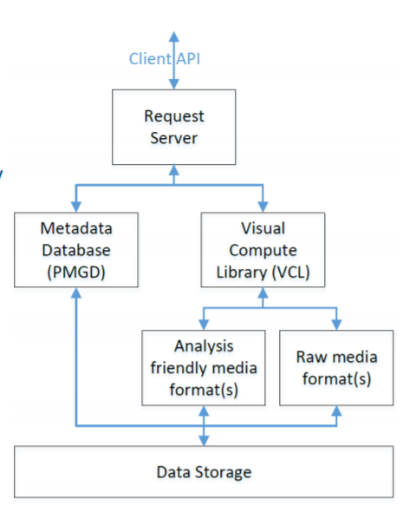
Today 공부한 내용
Visual Storage Architecture
각각이 위치한 곳?
역할
5. Retrieve data from storage
1. request: Find all photos of Alice from Hawaii
3. convert
4. Write analysis friendly media formatted-data
2. Read raw data
Notes:
Memory bandwidth is the rate at which data can be read from or stored into a semiconductor memory by a processor. Memory bandwidth is usually expressed in units of bytes/second, though this can vary for systems with natural data sizes that are not a multiple of the commonly used 8-bit bytes.

Slide 9
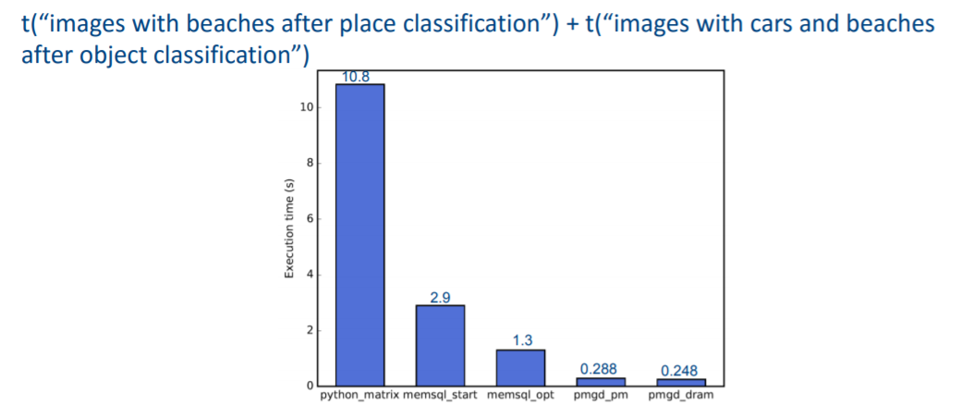
Today 공부한 내용
Metadata Query Comparison
Python_matrix(Numpy)
Memsql : not require buffer pool, in-memory row store
Memsql_start: no query caching
Memsql_opt : multiple tries
Pmgd_pm :executed PM latency( 의미?)
Pmgd_dram: executed DRAM latency with PMGD persisted on a SSD
Notes:
Memory bandwidth is the rate at which data can be read from or stored into a semiconductor memory by a processor. Memory bandwidth is usually expressed in units of bytes/second, though this can vary for systems with natural data sizes that are not a multiple of the commonly used 8-bit bytes.

Slide 10
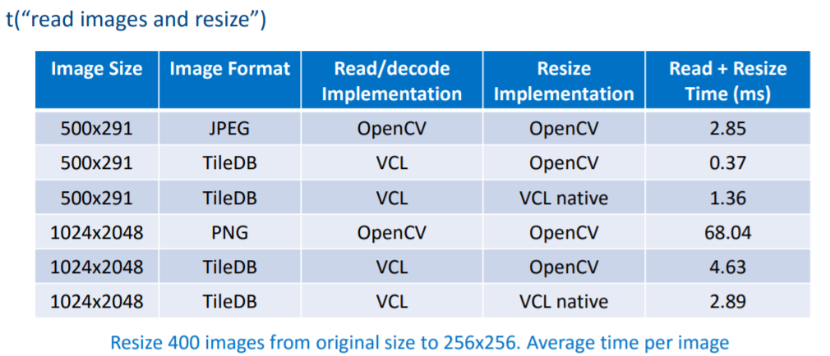
Today 공부한 내용
Analysis friendly processing in VCL ex. Resize
Not optimized for small size data
Larger the image, the performance of VCL is better
Notes:
Memory bandwidth is the rate at which data can be read from or stored into a semiconductor memory by a processor. Memory bandwidth is usually expressed in units of bytes/second, though this can vary for systems with natural data sizes that are not a multiple of the commonly used 8-bit bytes.

Slide 11
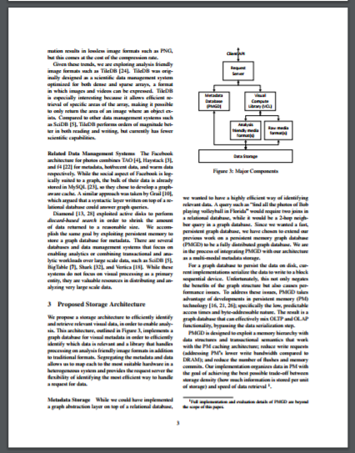
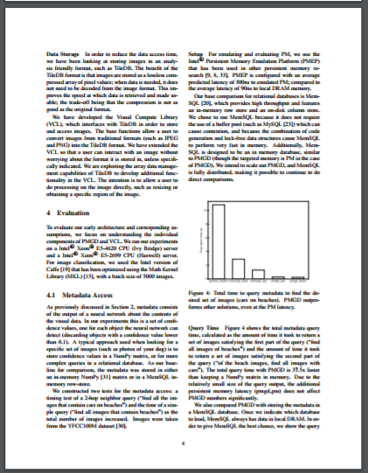
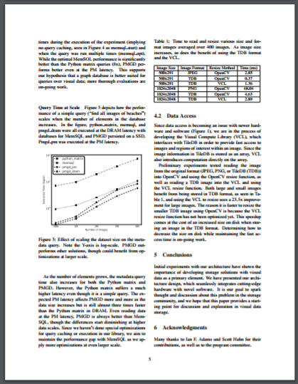
Today 공부한 내용
3p 4p 5p

